Slide 1
Sample Essay 2 Citation & Plagiarism

Slide 3
CITATION REVISITED
In-Text Citation
With multiple authors, parenthetical citations need to include the author or editor’s (last) name: e.g. (Chism 63); (Ibn Battuta 456); (Gibb 456)
Unless: their name is clearly in the preceding text
‘As Chism writes, “Ibn Battuta’s Rihla instead shows us a cosmopolitanism in process” (60).’
Generally, place the parenthetical at the end of the sentence, unless doing so would make it less clear.
When you repeatedly cite the same source and page, you may not need to include a citation every time.

Slide 4
CITATION REVISITED
“But once you have a case to make, careful citing is at once a service, a moral obligation, and an argumentative advantage.”
– Harvey, Writing with Sources, 13

Slide 5
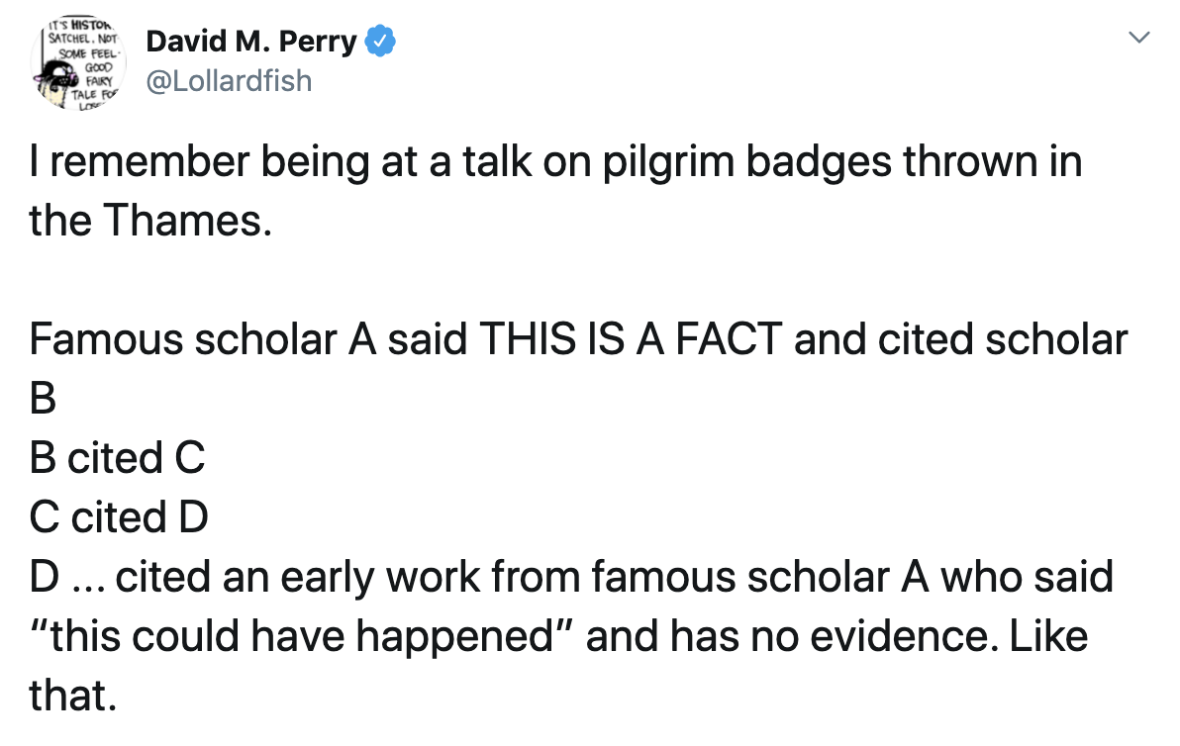
CITATION REVISITED

Slide 6
Types of Plagiarism Types of Plagiarism
Uncited data or information
Data or facts that aren’t common knowledge
“Nearly 40% of undergraduates say they have plagiarized at least once”
Deep background information
If you have to rely heavily on a source for background information, cite it
What is “Common Knowledge?”
Data or facts that are easy to look up, and/or widely accepted
NB: This can vary by audience
“Ibn Battuta was a Moroccan scholar who lived in the fourteenth century”

Slide 7
Types of Plagiarism Types of Plagiarism
Uncited ideas, whether specific or general concepts
“Chism argues that Ibn Battuta learns how to ‘improvise grounds of connection,’ which is only possible if he himself possesses a form of transcultural curiosity” (Chism 60).
“The Islamicate world was not nearly as unified as it may seem.”

Slide 8
Types of Plagiarism Types of Plagiarism
Unquoted, but verbatim phrase or passage
“Ibn Battuta learns how to resist backing away from the discomforts of meeting other cultures and improvise grounds of connection.”
Original:
“My answer is—he learns how to resist withdrawing from the discomforts and aversions of transcultural encounters with alien Muslims and non-Muslims, and instead learns how to improvise grounds of connection” (Chism 60).

Slide 9
Types of Plagiarism Types of Plagiarism
An uncited structure or organizing strategy
“Ibn Battuta overcomes his aversion to encountering other cultures in a variety of situations during his travels. First, he has to confront strange forms of Islam with which he is unfamiliar. Second, he must adapt to the unusual degree of freedom and autonomy given to women in Anatolia and the Mongol Khanate. Finally, he more broadly gets used to encountering a variety of other religious and cultural practices.”

Slide 10
Types of Plagiarism Other Misuse of Sources
Misrepresenting evidence
Cherry picking arguments
Omitting words and phrases that change the meaning
Improper collaboration
Dual or overlapping submission
Aiding or abetting plagiarism

